Slide 1

Expansion of the Epidemic Model and Economic Analysis
Kaylee Vo,
Tadhg Scannell
Notes:
Tadhg

Slide 2
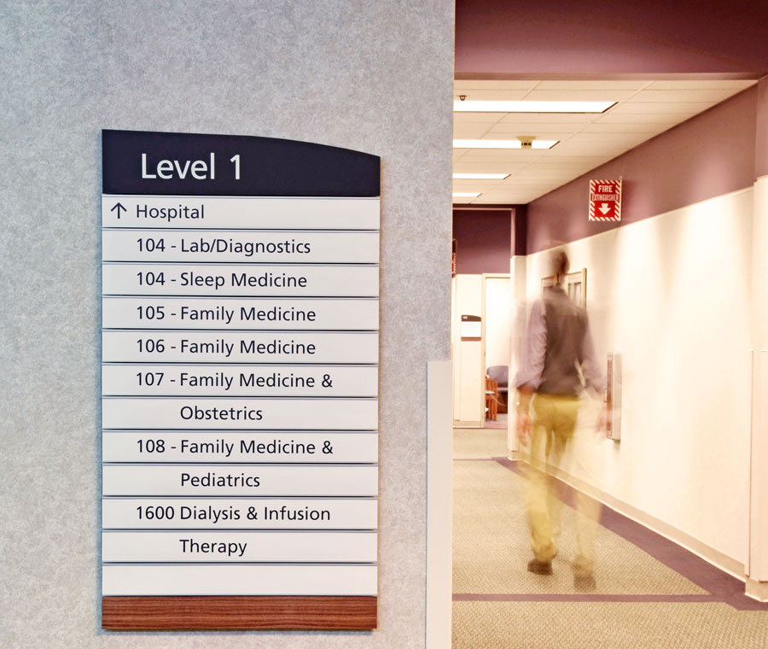
Agenda
Problem and Motivation
Approach
Expansion on SIR
Economic Evaluations Models
Assumptions
Model Results
Sensitivity Analysis
Conclusion
Appendix
Photos from https://www.apcosigns.com/divinesavior.html
Notes:
Tadhg

Slide 3



Problem and Motivation
The SIR model is a useful tool, but it ignores some crucial practicalities.
Not all sick people recover.
The transmission rate is not a time independent.
In isolation, the path forward is clear. Populations should isolate as much as possible, as there is no repercussion.
However, we know that this is not how the world works, so can the model be changed and built upon to gain more insight?
Photos from https://www.vecteezy.com/free-vector/healthy-sick and https://www.istockphoto.com/illustrations/scale
Notes:
Tadhg

Slide 4
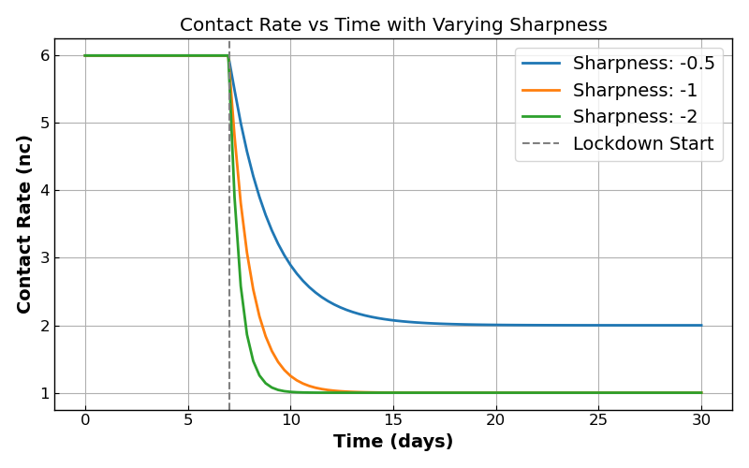
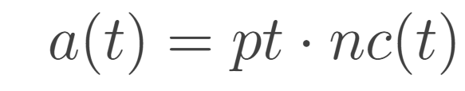
SIR to SEIRD (Beckley et al.)[3]
New Coefficients
c – vaccination rate, the rate at which susceptible individuals are considered recovered.
γ – mutation rate, the rate at which recovered individuals become susceptible.
ν - the incubation rate, the rate at which exposed individuals become infected.
η – mortality rate, the rate at which infectious individuals become deceased.
S – sharpness, the exponential rate of decline in number of contacts between individuals.
Modifications
Turn our transmission rate from a constant to a time dependent variable, used to reflect a difference in transmission rate based on lockdown strategies. This is calculated by the number of contacts times the probability of transmission.
Number of contacts was calculated with the rate determined by a lockdown strategy sharpness.
Figure 1: Number of contacts as a function of time during a lockdown strategy
Notes:
Kaylee

Slide 5
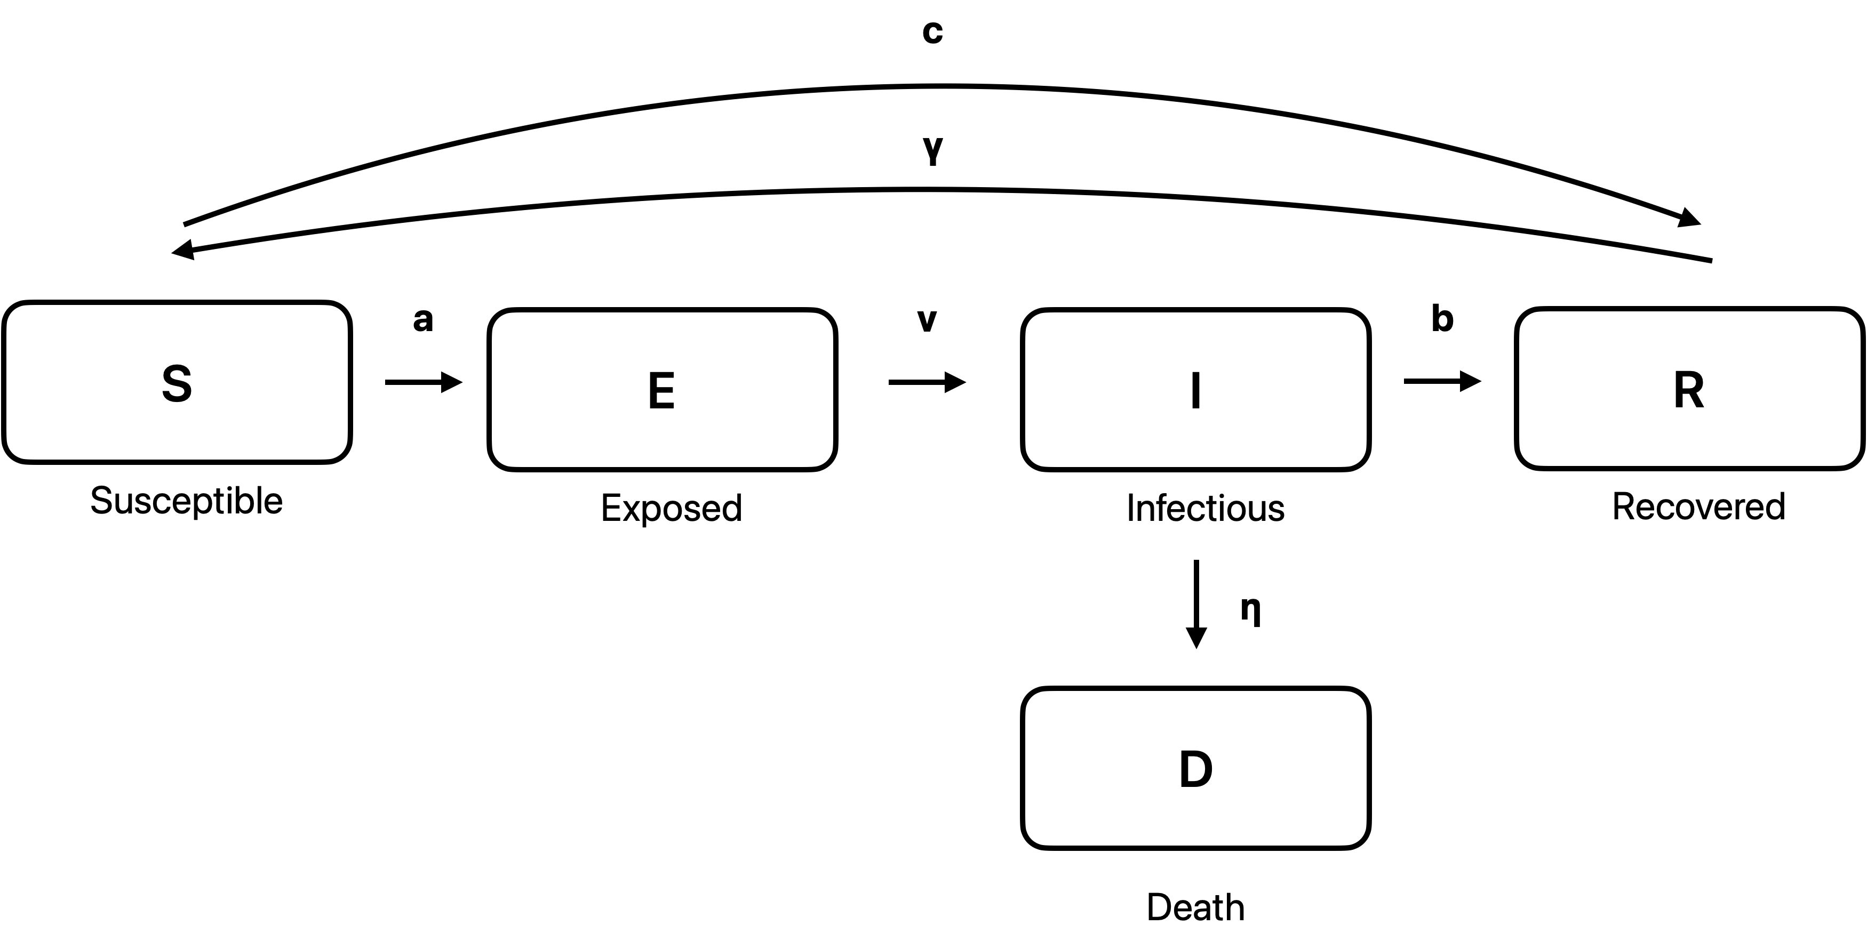
SIR to SEIRD cont.
Y
S
a
I
b
R
Susceptible
Infected
Recovered
Diagram 1: SIR model
Diagram 1: SEIRD model
Notes:
Kaylee

Slide 6
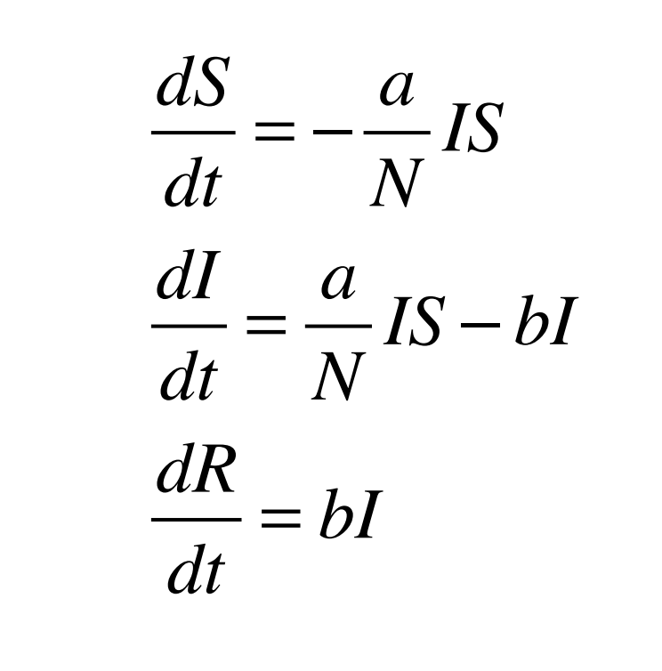
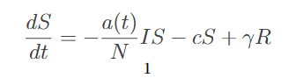
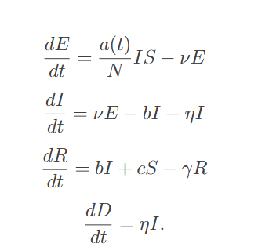
SIR to SEIRD ODES
SIR Model ODE’s
SEIRD Model ODE’s
Notes:
Kaylee

Slide 7
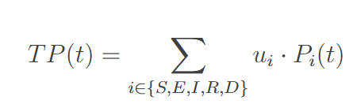
Economic Costs of Epidemic
Two methods to calculate Economic Impact:
Total Cost Calculation:
Calculates the total cost associated with the value associated with death, plus a decrease in GPD associated with reduction in contacts, plus the cost of caring for patients in a hospital.
Unit of Productivity Calculation:
Calculates the total productivity of a SEIRD model population by summing up the expected productivity from each demographic at a given time t.
Notes:
Tadhg

Slide 8
Assumptions
Population Size
Value: 2 million.
Justification: reflect a mid sized metropolitan area, similar in size to Cleveland, OH or San Jose, CA.
Transmission Rate:
Value: 0.1
Justification: derived to match the R0 observed by in 2020 when multiplied with a initial number of contacts equal to 6, reasonable given the Dunbar number from Scotch [11].
Vaccination Rate:
Value: 0.015
Justification: In 2020-2021, the rate was around .013, as shown by Mathieu et al[8].
Mutation Rate:
Value: 0.008
Justification: In 2020-2021, the rate was around .008, as shown by Manica et al[7].
Incubation Rate:
Value: 0.22
Justification: In 2020-2021, the incubation rate was approximately 5 days, as observed by AlQadi et al[1].
Mortality Rate:
Value: 0.01
Justification: In 2020-2021, Mathieu et al[8] documented case fatality rate, which we converted to a mortality rate.
Recovery Rate:
Value: 0.05
Justification: This is in line with the recovery rate observed by Oelsner et al [10].
Hospital Cost:
Value: $15,000
Justification: Kapinos et al[6] documented cost for COVID-19 treatments in 2020 and derived to this use case.
Hospital Capacity:
Value: 0.3% of the population, or 6000
Justification: Derived from data provided by the American Health Association on available hospital beds[2].
Total GDP per Day
Value: $1 Billion
Justification: Assumption from the team derived from the midpoint of income levels in low and high income MSA’s.
Value of Life:
Value: $15 Million
Justification: The Federal Aviation Administration[5] suggests a range of $7.9 million to $18.5 million for value of a statistical life. With that guidance, $15 million is reasonable.
Notes:
Tadhg

Slide 9
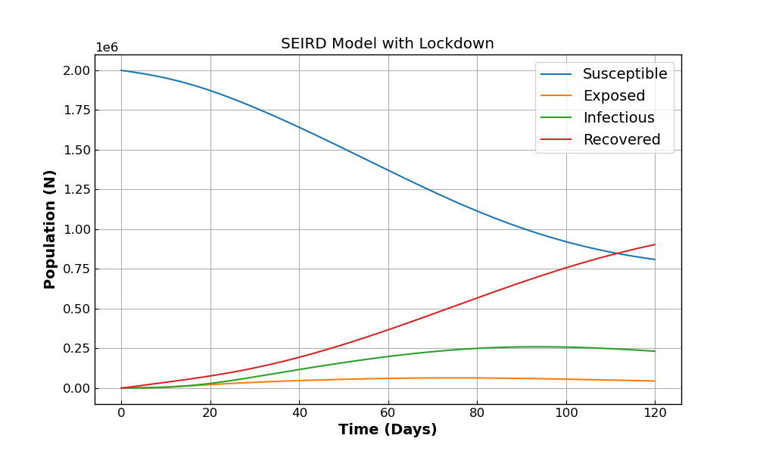
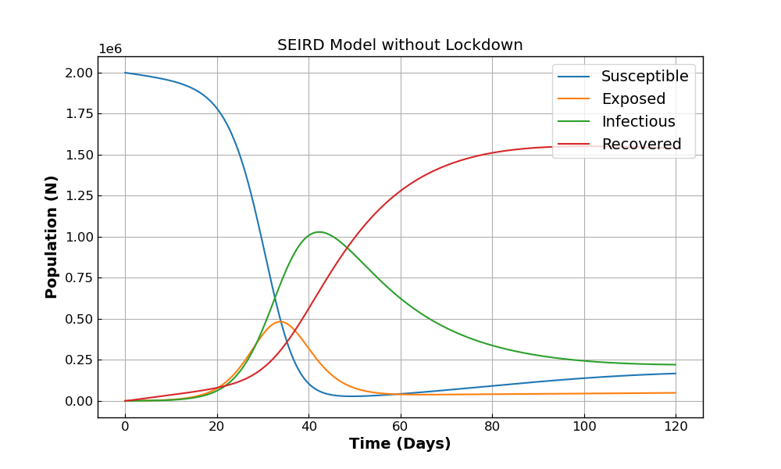
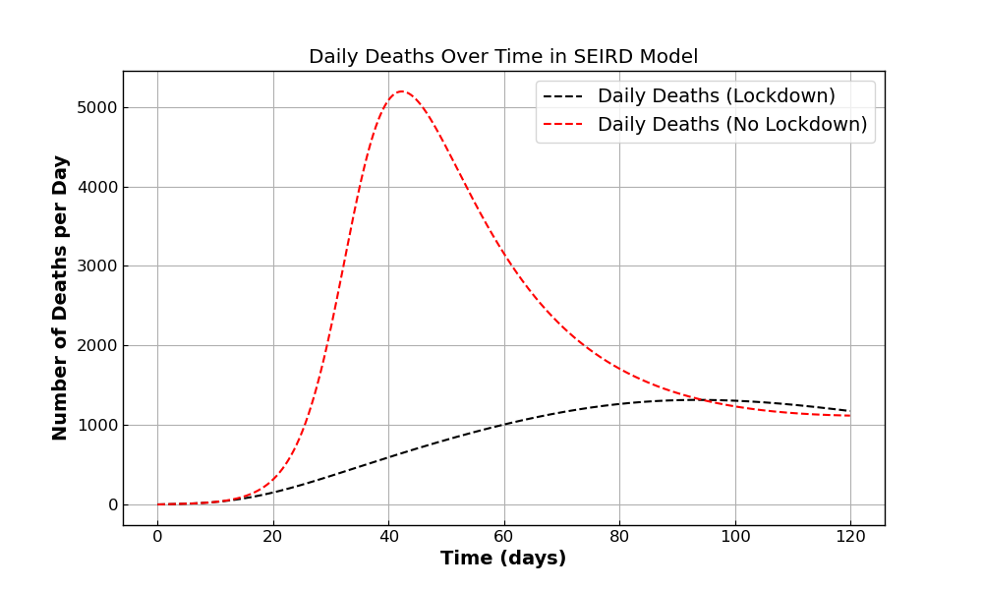
SEIRD Models Results
Figure 2
Figure 3
Parameters:
Population [S, E, I, R, D] = [1.998.000, 2000, 0, 0, 0 ]
Figure 4
Vaccination Rate: 0.69/365
Mutation Rate: 0.008
Incubation Rate: 0.22
Mortality Rate: .01
Lockdown Sharpness: -0.1
Transmission Rate: 0.1
Recovery Rate: 0.05
Notes:
Kaylee

Slide 10

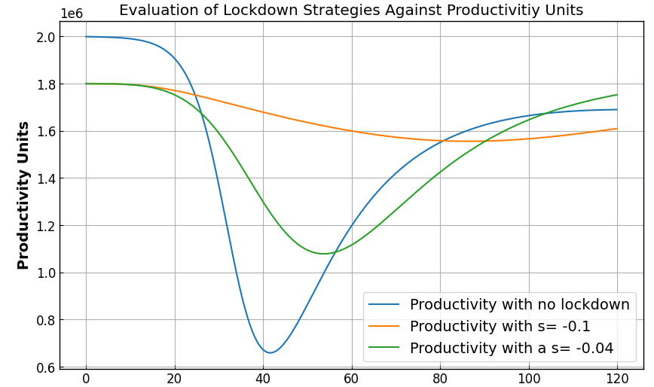
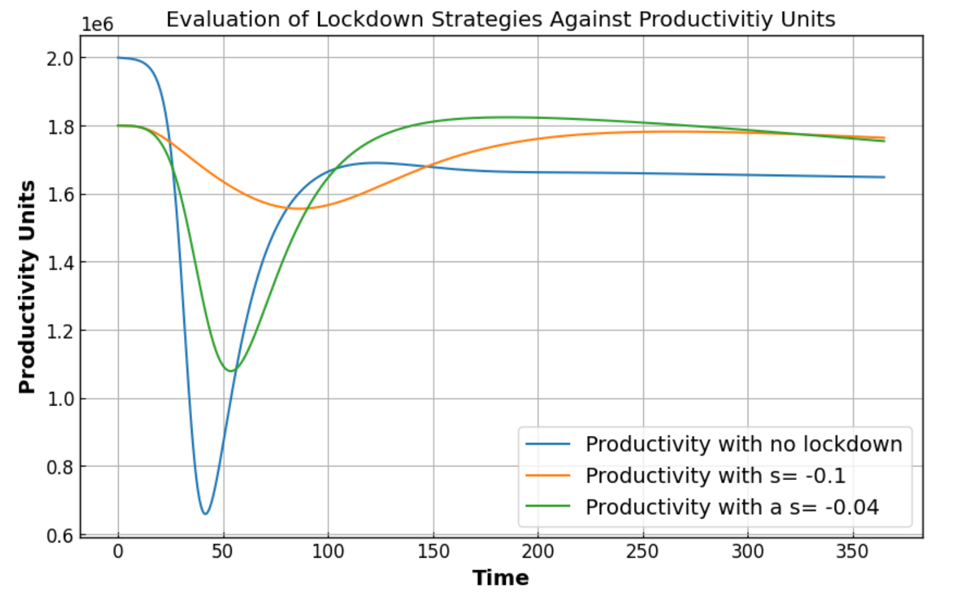

Productivity Associated with Lockdown Strategies
Scenario 1
S : 1, a healthy individual contributes 1 unit. This is the comparison point
E: 0.8, an exposed individual on average contributes 0.8 productivity units, an assumption from the group.
I: -0.25, an infected individual requires care, with registered nurse to patient ratios taken from House Bill 2697 from Oregon []
R: 1, considered a healthy individual
D: 0, a deceased individual does not contribute any productivity units
Scenario 2 (s=-0.1) & 3 (s =-0.04)
Figure 5
Figure 6
S : .9 – a person working in lockdown is estimated to be 10% less effective, from Gibs et al []
E: 0.8, an exposed individual on average contributes 0.8 productivity units, an assumption from the group.
I: -0.25, an infected individual requires care, with registered nurse to patient ratios taken from House Bill 2697 from Oregon []
R: .9, considered a healthy individual working in lockdown
D: 0, a deceased individual does not contribute any productivity units
Notes:
Tadhg

Slide 11
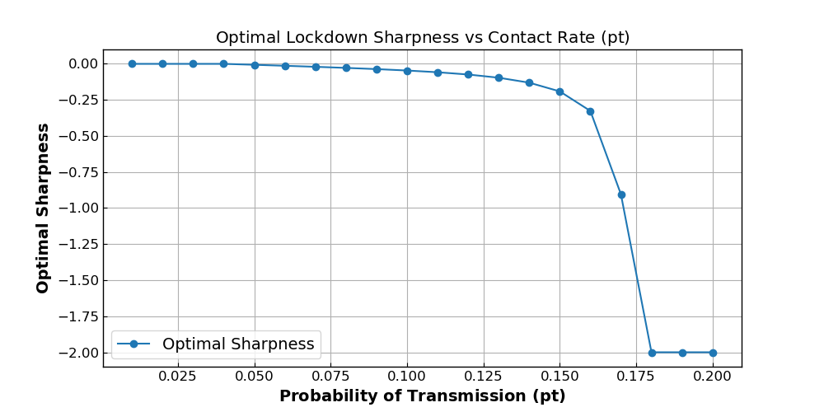
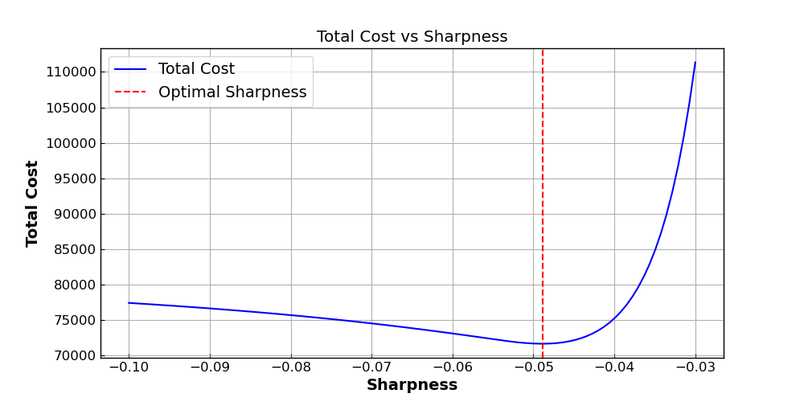
Optimal Sharpness
Figure 7
Figure 8
Parameters:
Population [S, E, I, R, D] = [1.999.999, 1, 0, 0, 0 ]
Parameters:
Population [S, E, I, R, D] = [1.999.999, 1, 0, 0, 0 ]
Vaccination Rate: 0.0018
Mutation Rate: 0.008
Incubation Rate: 0.22
Mortality Rate: .01
Recovery Rate: 0.05
Hospital Capacity: 6000
GDP per Day: $1 Billion
Value of Life: $15 million
Vaccination Rate: 0.0018
Mutation Rate: 0.008
Incubation Rate: 0.22
Mortality Rate: .01
Transmission Rate: 0.1
Recovery Rate: 0.05
Hospital Capacity: 6000
GDP per Day: $1 Billion
Value of Life: $15 million
Notes:
Kaylee

Slide 12
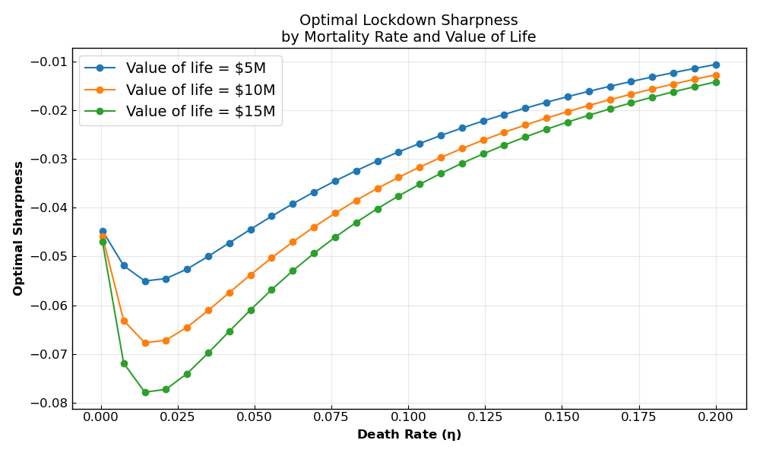
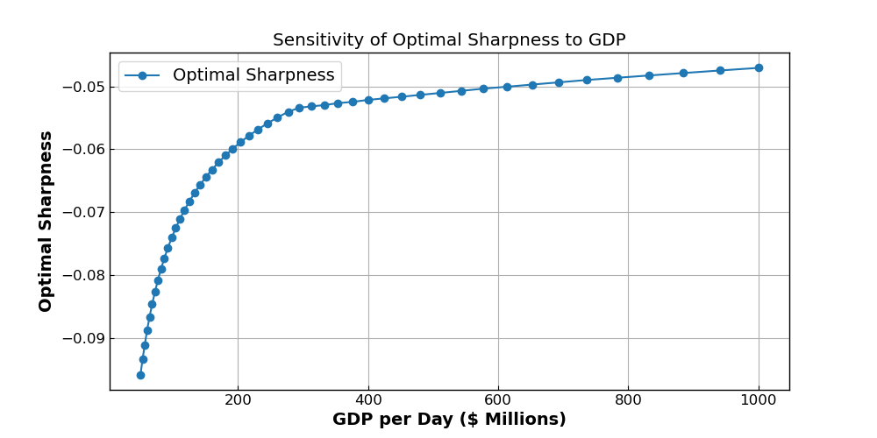
Sensitivity Analysis
Figure 9
Figure 10
Parameters:
Population [S, E, I, R, D] = [1.999.999, 1, 0, 0, 0 ]
Parameters:
Population [S, E, I, R, D] = [1.999.999, 1, 0, 0, 0 ]
Hospital Capacity: 6000
GDP per Day: 1000
Hospital Capacity: 6000
Value of Life: $15 million
Vaccination Rate: 0.0018
Mutation Rate: 0.008
Incubation Rate: 0.22
Transmission Rate: 0.1
Recovery Rate: 0.05
Vaccination Rate: 0.0018
Mutation Rate: 0.008
Incubation Rate: 0.22
Mortality Rate: .01
Transmission Rate: 0.1
Recovery Rate: 0.05
Notes:
Kaylee

Slide 13
Conclusion
Expanded SIR to include two new states for Exposed and Dead.
Changed the transmission rate to a time dependent variable to reflect lockdown strategy impacts.
Analyzed an economic impact of the epidemic model from a productivity output perspective.
Executed an economic impact sensitivity analysis on the updated models evaluating lockdown strategies against Value of Life and GDP.
Notes:
Tadhg

Slide 14
References
[1] AlQadi, Hadeel, and Majid Bani-Yaghoub. “Incorporating global dynamics to improve the accuracyof disease models: Example of a COVID-19 SIR model.” PLoS ONE, vol. 17, no. 4, Apr. 2022, p.e0265815. https://doi:10.1371/journal.pone.0265815
[2]“Fast Facts on U.S. Hospitals, 2025 — AHA.” American Hospital Association, 31 Jan. 2025,www.aha.org/statistics/fast-facts-us-hospitals.
[3] Beckley, Ross, et al. “Modeling epidemics with differential equations.”https://www.tnstate.edu/mathematics/mathreu/filesreu/GroupProjectSIR.pdf, Tennessee StateUniversity, 21 June 2023, www.tnstate.edu/mathematics/mathreu/filesreu/GroupProjectSIR.pdf.Accessed 5 July 2025
[4] Gibbs, M, Mengel, F., and Siemroth, C (2023). Work From Home and Productiv-ity: Evidence from Personnel and Analytics Data on Information Technology Professionals. Journalof Political Economy Microeconomics 2023 1:1, 7-41. https://doi.org/10.1086/721803
[5] Federal Aviation Administration. (2024). Treatment of the values of life and injury in economic analysis. U.S. Department of Transportation. https://www.faa.gov/regulations_policies/policy_guidance/benefit_cost/econ-value-section-2-tx-values.pdf
[6] Kapinos, Kandice A., et al. “Inpatient Costs of Treating Patients With COVID-19.” JAMA NetworkOpen, vol. 7, no. 1, Jan. 2024, p. e2350145, doi:10.1001/jamanetworkopen.2023.50145.
[7] Manica, M., Litvinova, M., De Bellis, A., Guzzetta, G., Mancuso, P., Vicentini, M., Venturelli, F.,Bisaccia, E., Bento, A. I., Poletti, P., Marziano, V., Zardini, A., D’Andrea, V., Trentini, F., Bella, A.,Riccardo, F., Pezzotti, P., Ajelli, M., Rossi, P. G., & Merler, S. (2022). Estimation of the incubationperiod and generation time of SARS-CoV-2 Alpha and Delta variants from contact tracing data.Epidemiology and Infection, 151. https://doi.org/10.1017/s0950268822001947
[8] Mathieu, E., Ritchie, H., Rod´es-Guirao, L., Appel, C., Gavrilov, D., Giattino, C., Hasell, J., Macdon-ald, B., Dattani, S., Beltekian, D., Ortiz-Ospina, E., & Roser, M. (2020, December 16). Coronavirus(COVID-19) vaccinations. Our World in Data. https://ourworldindata.org/covid-vaccinations
[9] Oregon H.B. 2697, 82nd Leg., Reg. Sess. (2023
[10] Oelsner, E. C., Sun, Y., Balte, P. P., Allen, N. B., Andrews, H., Carson, A., Cole, S. A., Coresh, J.,Couper, D., Cushman, M., Daviglus, M., Demmer, R. T., Elkind, M. S. V., Gallo, L. C., Gutierrez,J. D., Howard, V. J., Isasi, C. R., Judd, S. E., Kanaya, A. M., . . . Post, W. S. (2024). Epi-demiologic features of recovery from SARS-COV-2 infection. JAMA Network Open, 7(6), e2417440.https://doi.org/10.1001/jamanetworkopen.2024.17440
[11] Scotch. Dunbar’s Number. modelthinkers.com/mental-model/dunbars-number.

Slide 15
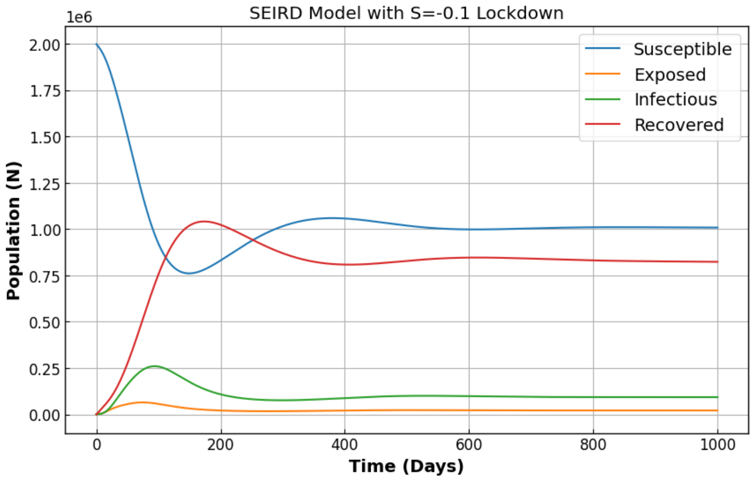
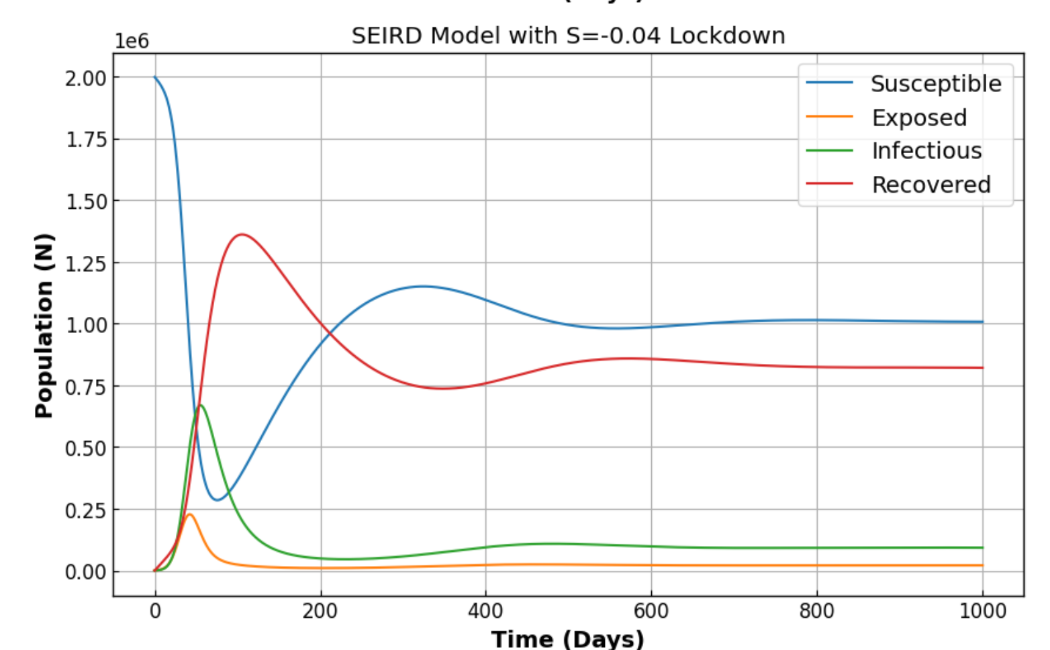
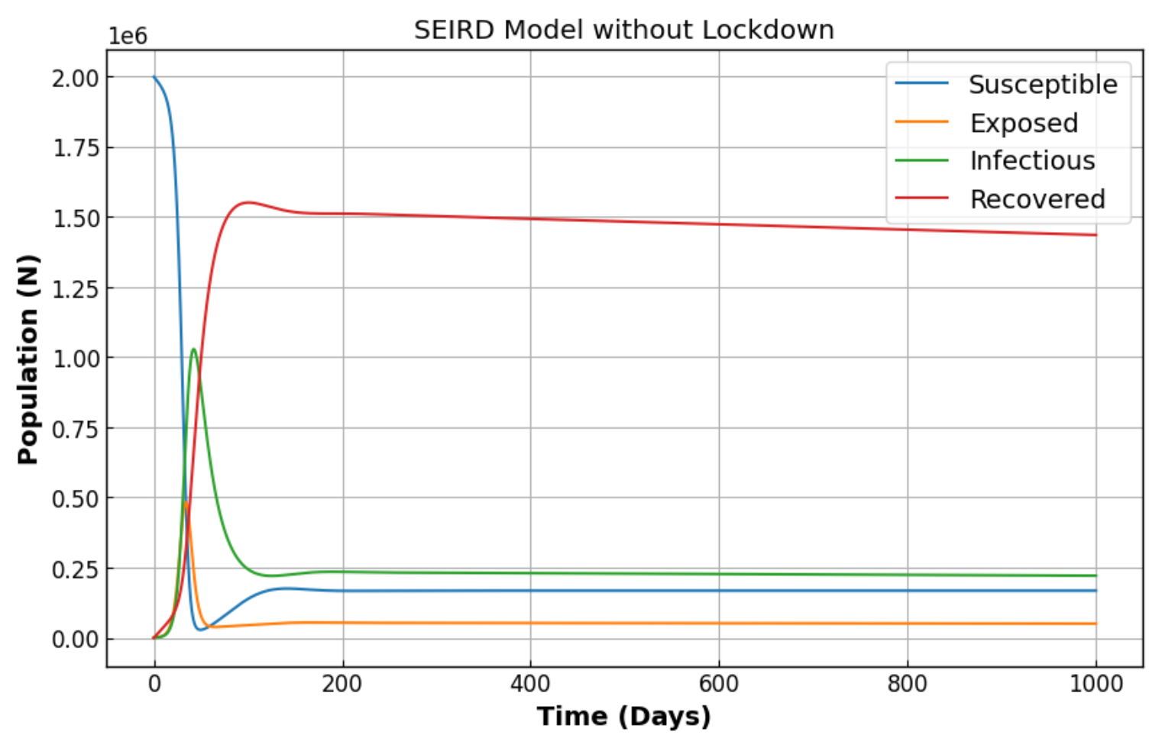
Appendix Items – Long Term Models
Notes:
Tadhg

